Slide 1
Waste Management
Team – “AS YOU LIKE IT”
INTERNITY Foundation - CreateAThon

Slide 2



C O N C E P T
CONCEPT
Selling Waste material Online
Recycle
Waste
WASTE
CONCEPT
Preserving Environment
Providing educational opportunity to village students
Management
Categorizing papers on the basis of quality.
CONCEPT
Develop connectivity between scrap dealer and customer

Slide 3
PURPOSE
In India more than 550 mills make use of waste paper as the main raw material for making paper, paperboard and for production of newsprint. Waste paper is collected indigenously and also imported. In this country, every year around three million tonnes of waste paper is recovered, which is only about 20% of the total. When we compare this with other countries, the amount is comparatively very low. For instance, developed countries like Germany recovers 73% waste paper, Sweden 69%, Japan 60%, USA 49% etc.

Slide 4
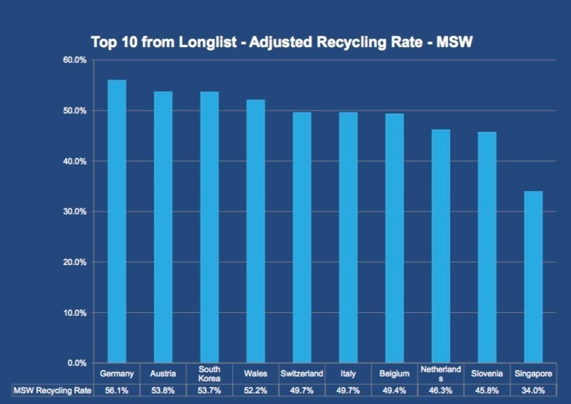
I N F O G R A P H I C

Slide 5
O B J E C T I V E S
Weighing and payment
CONFIRM DELIVERY
Worker will weigh the material based on which payment will be initiated
confirmation of received material from storage area
CONFIRM ORDER
Confirmation of order
If driver is available
STORING MATERIAL
6
4
PLACE ORDER
2
ORDER DETAILS
Storing the material at warehouse
Customer will place an order
Send OTP and customer address
5
1
3

Slide 6
O B J E C T I V E S
Contact village school to provide them with the book received at low price
SEPARATING MATERIAL
PAYMENT RECEIVED FROM SCRAB DEALERS AND VILLAGE SCHOOL
Segregating material a different categories
Contact scrap dealers for plastic and metal
7
9
10
8

Slide 7
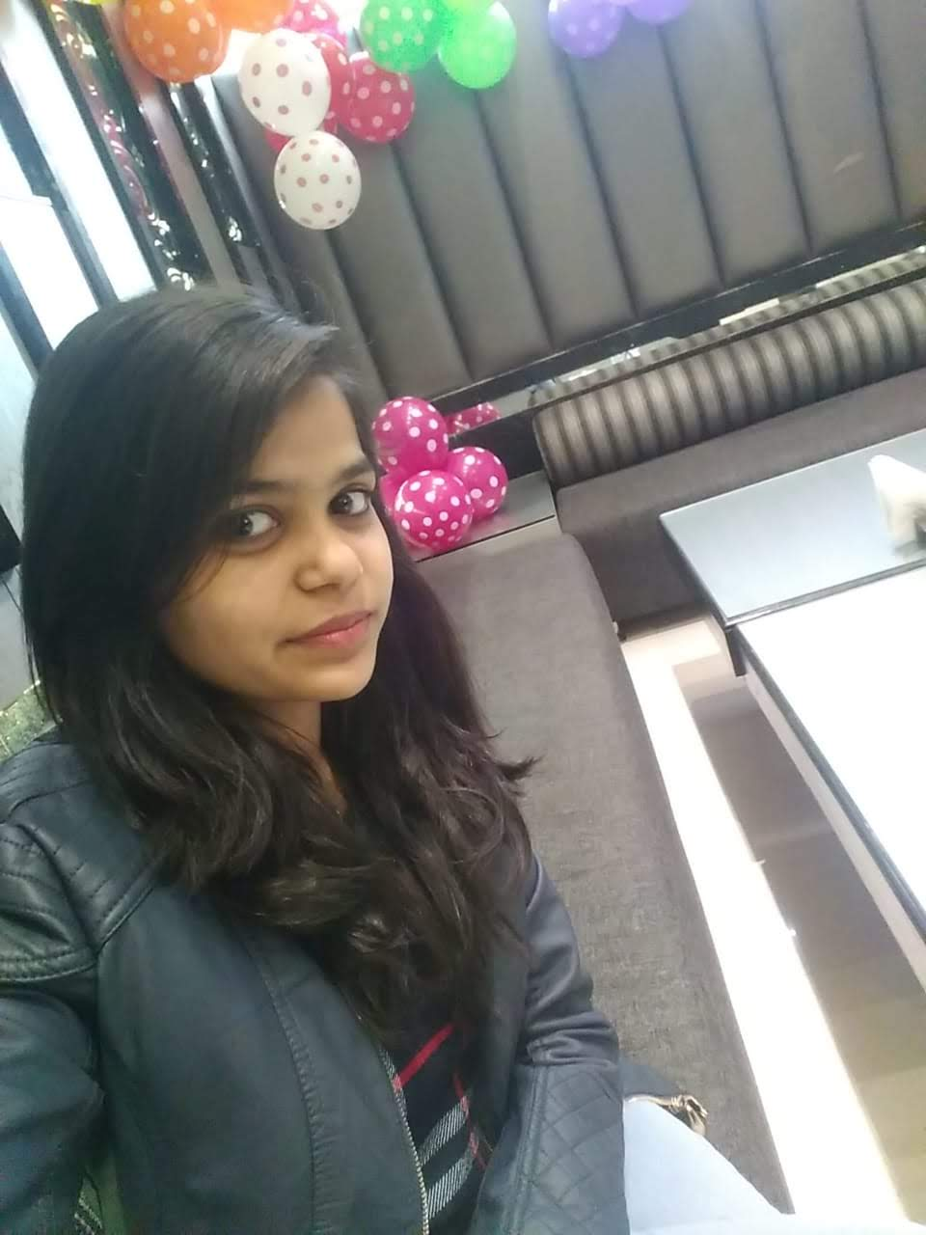
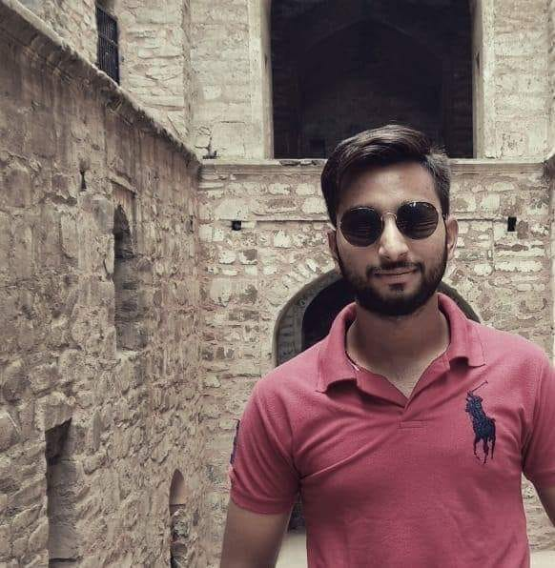

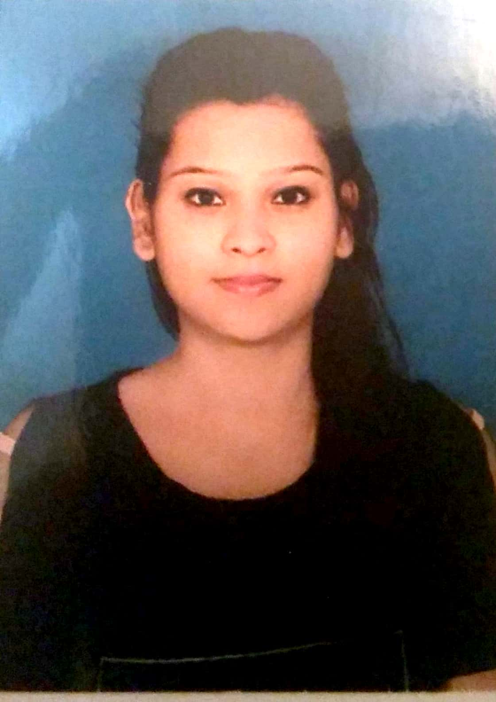
O U R T E A M C R E W
SANCHI BANSAL
AMIT KUNTAL
RUPALI GOYAL
SHIVAM PARASHAR
JAVA DEVELOPER
PYTHON AND PHP DEVELOPER
JAVA DEVELOPER
ANGULAR AND JAVA DEVELOPER

Slide 8

T H A N K YOU

